Slide 1
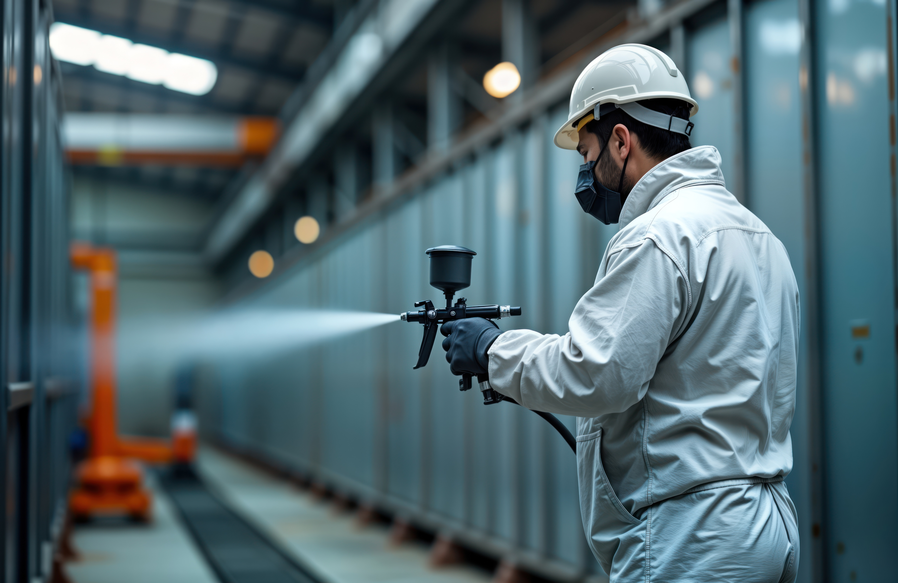
Incozol-341 LV - Switch Effortlessly. Save Instantly.

Slide 2

You asked and we listened…….
"We value your product/service and want to make this work—are there any pricing options you could offer?
“The one area where our testing showed a slight downside was the film hardness”
“Is there anything new in the Incozol range?”

Slide 3

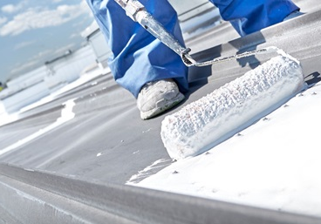
The development of Incozol-341 LV
Why?
Incozol LV was developed in the 90s and we know much more about Oxazolidine technology now
The formulation is impacted by ongoing increases in raw material prices
Customer feedback has given us input for development
We proactively updated our manufacturing processes to meet health and safety regulations

Slide 4

Introducing Incozol-341 LV
Better performance than Incozol LV
Drop in replacement
Better value

Slide 5
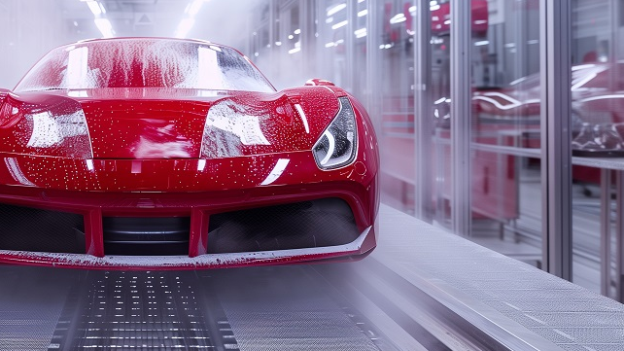
Summary – 2k pu automotive refinish clearcoat
✓✓ = Good ✓✓✓ = Excellent
 | Incozol LV Standard | Incozol-341 LV
Appearance | ✓✓✓ | ✓✓✓
Potlife | 40 | 40
1 day hardness | ✓✓ | ✓✓✓
7 day hardness | ✓✓ | ✓✓✓
Drying time | ✓✓ | ✓✓✓
Chemical and Stain Resistance | ✓✓✓ | ✓✓✓
Abrasion Resistance | ✓✓ | ✓✓✓
Scratch resistance (abraded steel) | ✓✓✓ | ✓✓✓
Mandrel bend | ✓✓✓ | ✓✓✓
Adhesion | ✓✓ | ✓✓✓

Slide 6

Summary – 2K PU heavy duty white topcoat
✓✓ = Good ✓✓✓ = Excellent
 | Incozol LV Standard | Incozol-341 LV
Appearance | ✓✓✓ | ✓✓✓
Potlife | 45 | 40
1 day hardness | ✓✓ | ✓✓✓
7 day hardness | ✓✓✓ | ✓✓✓
Drying time | ✓✓✓ | ✓✓✓
Chemical and Stain Resistance | ✓✓✓ | ✓✓✓
Abrasion Resistance | ✓✓✓ | ✓✓✓
Scratch resistance (abraded steel) | ✓✓ | ✓✓✓
Mandrel bend | ✓✓✓ | ✓✓✓
Adhesion | ✓✓ | ✓✓✓

Slide 7

Formulator-Ready: High-Performance Oxazolidine Innovation
Physical properties
Property | Incozol LV | Incozol-341 LV
Viscosity | 55 | 75
Colour (APHA) | Max 250 | Max 250
Equivalent Weight | 86 | 82

Slide 8
Dilution curve shows Incozol-341 LV has the same ability to reduce viscosity as Incozol LV

Slide 9
2k pu automotive refinish Clearcoat

Slide 10
Guide Formulation Incozol LV
2k pu automotive refinish clearcoat
Part A
Component |  | Parts by weight / g
Acrylic Polyol | Joncryl 507 | 47.70
UV Absorber | Tinuvin 1130 | 0.30
UV Stabiliser | Tinuvin 292 | 0.30
Flow & Levelling Additive | BYK 399 | 0.50
Solvent | Butyl Acetate | 43.40
Catalyst | TIB KAT 216 (10% Sol in BA) | 0.50
Moisture Scavenger | Incozol 2 | 2.00
Reactive Diluent | Standard Incozol LV/Incozol-341 LV | 5.30
The same formulation was used throughout, with the only variable being the reactive diluent
Formulated to the same VOC
A comparison was made between standard Incozol LV and the new Incozol-341 LV
Part B
Component |  | Parts by weight / g
PolyIsocyanate | Desmodur N3300 | 40.10

Slide 11
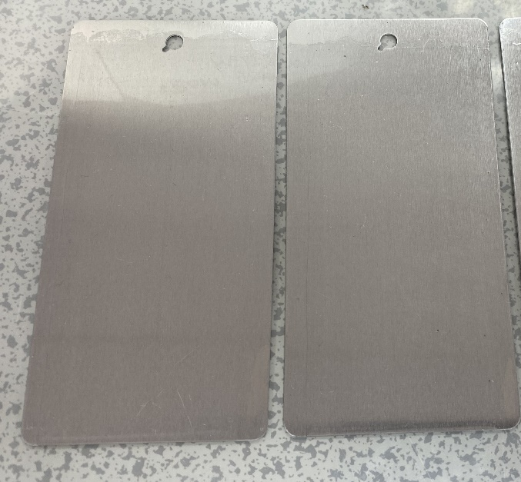
physical properties
Ask Georgina about Voc And solids
Offers comparable physical properties to Incozol LV and can be seamlessly substituted without the need for reformulation
Property | 2K PU Automotive Refinish Clearcoat (Inc LV Std) | 2K PU Automotive Refinish Clearcoat (Incozol-341 LV)
Pot Life (min) | 40 | 40
% Solids | 62.58 | 64.72
Mixed Viscosity (sec) - Ford Cup B4 | 18 | 21
Mixed SG (g/L) | 1.00 | 1.01
2K PU Automotive Refinish Clearcoat with Inc LV Standard
2K PU Automotive Refinish Clearcoat with Incozol-341 LV

Slide 12

dry film properties
Early hardness development - Improved 1 day and 7 day hardness when compared to Incozol LV
Property | 2K PU Automotive Refinish Clearcoat (Inc LV Std) | 2K PU Automotive Refinish Clearcoat (Incozol-341 LV)
Gloss @ 60° GU 1d | 198 | 197
Gloss @60° GU 7d | 195 | 194
Persoz Hardness (s) 1d | 77 | 121
Persoz Hardness (s) 7d | 254 | 271

Slide 13

Faster drying with Incozol-341 LV
Comparable drying time when compared to Incozol LV
15 minutes faster tack-free tie
Improved through dry time
No change in formulation required

Slide 14
Chemical and stain resistance
Same excellent chemical and resistance as formulation with standard Incozol LV
Scoring Key | 0 | film removal | 3 | heavy staining
 | 1 | heavy cracking | 4 | light staining
 | 2 | light cracking | 5 | no change
After 24 hours recovery time only light staining from Brake fluid can be observed.

Slide 15
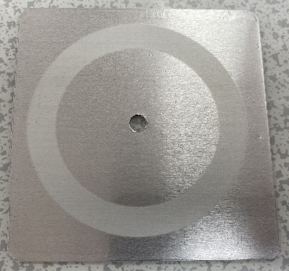
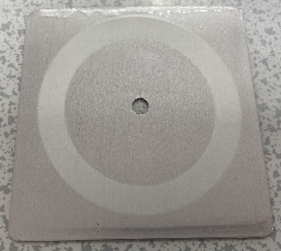
2k Taber abrasion test
Incozol LV Standard- after Taber Abrasion
Incozol-341 LV- after Taber Abrasion
*based on reduced material loss in Taber testing (33 mg vs. 47 mg
Enhanced ability to withstand wear and friction using Incozol-341 LV making it suitable for demanding applications

Slide 16

Scratch resistance
Maintains the scratch resistance performance of Incozol LV
Pass/Fail | 2K PU Automotive Refinish Clearcoat (Inc LV Std) |  |  |  | 2K PU Automotive Refinish Clearcoat (Incozol-341 LV)
 | Steel |  |  | Aluminum | Steel |  |  | Aluminum
 | Cleaned | Abraded | Not Abraded or Cleaned |  | Cleaned | Abraded | Not Abraded or Cleaned
Mark( g) | 200 | 200 | 200 | 100 | 200 | 200 | 200 | 100
Pass (g) | 4000 | 4000 | 4000 | 1100 | 4000 | 4000 | 4000 | 1100
Failed (g) | N/A | N/A | N/A | 1200 | N/A | N/A | N/A | 1200
Method Standard: BS3900 Part 2 - Scratch Resistance (max 4000g weight) : 7 days@room temp
Maintains scratch resistance even on unprepared surfaces
Performs consistently across steel and aluminium
No compromise in performance with Incozol-341 LV

Slide 17
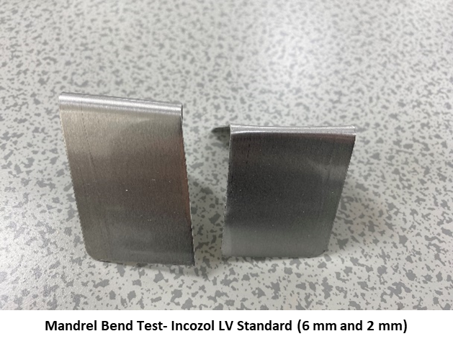
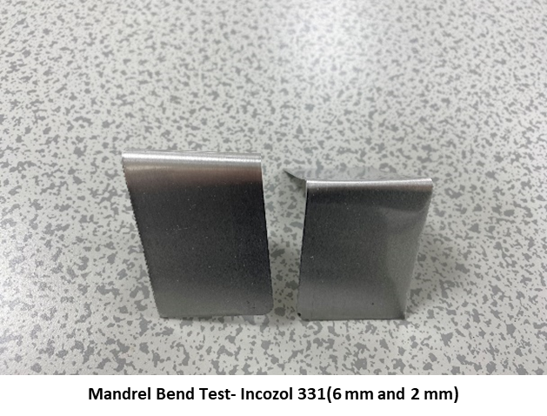

Same Superior flexibility as Incozol lv
Change 331 under this picture
Mandrel Size | 2K PU Automotive Refinish Clearcoat (Inc LV Std) | 2K PU Automotive Refinish Clearcoat (Incozol-341 LV)
2mm | Pass | Pass
6mm | Pass | Pass
Passes flexibility test at 6mm and 2mm
No cracking or delamination
Method Standard: ASTM D 522_A: 7 days@room temp

Slide 18


Cross Hatch Adhesion Test (Rank/ Percentage intact)
Superior adhesion even on non abraded substrate
Condition | 2K PU Automotive Refinish Clearcoat (Inc LV Std) | 2K PU Automotive Refinish Clearcoat (Incozol-341 LV)
Cleaned | 4B- 97% | 5B- 100%
Abraded and Cleaned | 5B- 100% | 4B- 99%
Not Abraded or Cleaned | 4B- 96% | 5B- 100%
Adhesion scoring key
5B | 0% removed
4B | <5 %removed
3B | 5% to 15% removed
2B | 15% to 35% removed
1B | 35% to 65% removed
0B | >65% removed
Method/Standard: ASTM D 3359: 7 days @ room temp
100% adhesion on unprepared surfaces with Incozol-341 LV
No cracking or delamination
Offers improved impact resistance

Slide 19
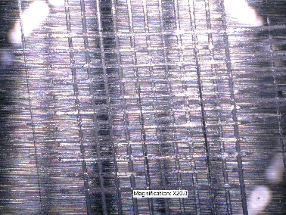
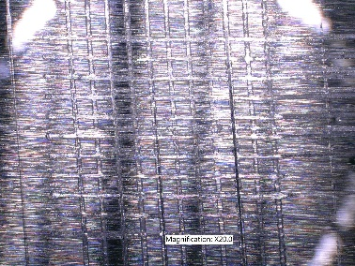
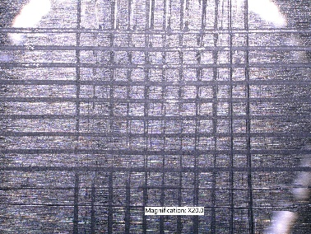
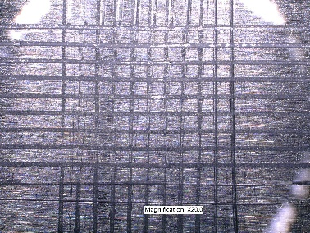
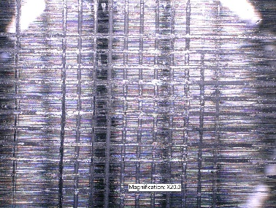
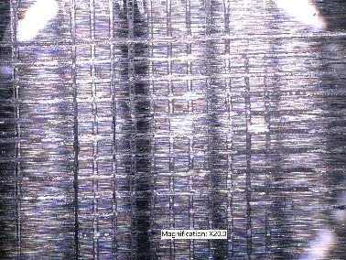
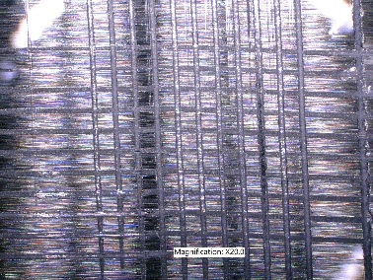
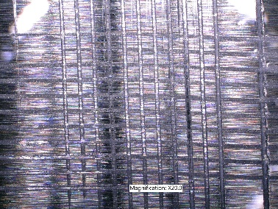
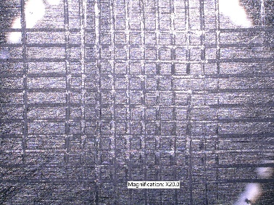
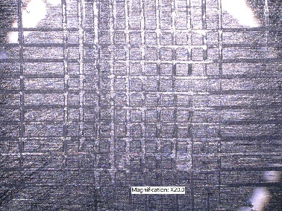
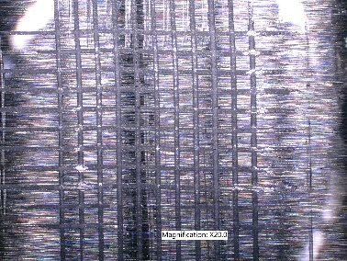
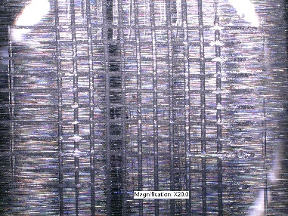
Adhesion Test (Cross Hatch)
Incozol LV Standard
Incozol LV Standard- Cleaned before tape
Incozol LV Standard- Cleaned after tape
Incozol LV Standard- Abraded before tape
Incozol LV Standard- Abraded after tape
Incozol LV Standard- Not Abraded or Cleaned before tape
Incozol LV Standard- Not Abraded or Cleaned after tape
Incozol-341 LV
Incozol-341 LV - Cleaned before tape
Incozol-341 LV - Cleaned after tape
Incozol-341 LV - Abraded before tape
Incozol-341 LV - Abraded after tape
Incozol-341 LV - Not Abraded or Cleaned before tape
Incozol-341 LV - Not Abraded or Cleaned after tape

Slide 20
2k pu heavy duty white topcoat

Slide 21
Guide Formulation
2k pu Heavy Duty wHITE Topcoat
Ask GG about theoretical VOC
Part A
Component |  | Parts by weight / g
Acrylic Polyol | Joncryl 507 | 40.50
Pigment | Tiona 595 | 17.00
UV Absorber | Tinuvin 1130 | 0.30
UV Stabiliser | Tinuvin 292 | 0.30
Flow & Levelling Additive | Dynoadd F-1 | 0.50
Solvent | Butyl Acetate | 34.4
Catalyst | TIB KAT 216( 10% Sol in BA) | 0.50
Moisture Scavenger | Incozol 2 | 2.00
Reactive Diluent | Standard Incozol LV/Incozol-341 LV | 4.50
The same formulation was used throughout, with the only variable being the reactive diluent
A comparison was made between standard Incozol LV and the new Incozol-341 LV
Part B
Component |  | Parts by weight / g
PolyIsocyanate | Desmodur N3300 | 34.6

Slide 22
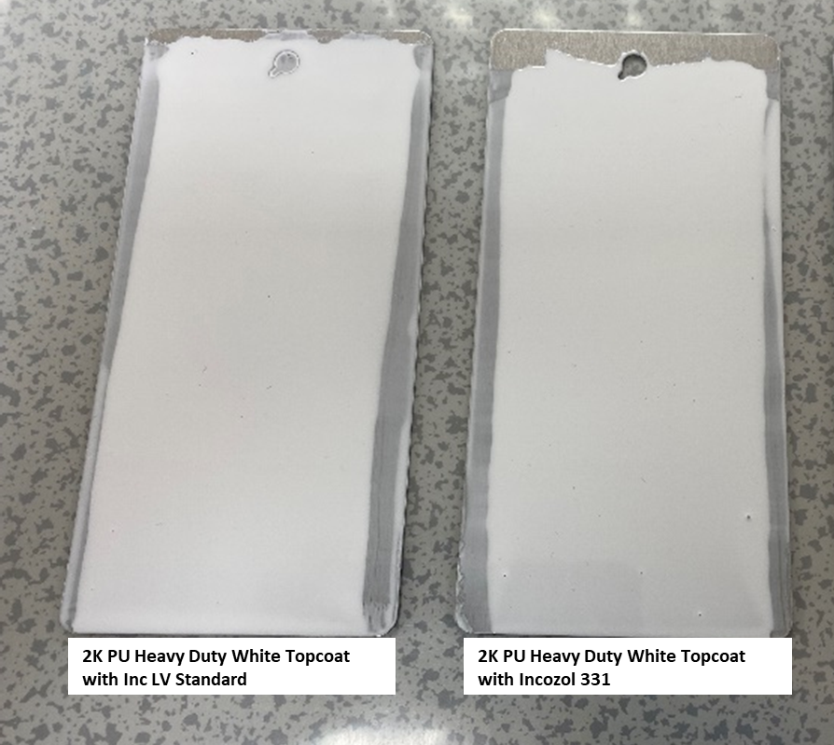
physical properties
Ask GG about solids and VOC
Offers comparable physical properties to Incozol LV and can be seamlessly substituted without the need for reformulation
Property | 2K PU Heavy Duty White TC (Inc LV Std) | 2K PU Heavy Duty White TC (Incozol-341 LV)
Pot Life (min) | 45 | 40
% Solids | 72.24 | 71.95
Mixed Viscosity (sec) - Ford Cup B4 | 22 | 21
Mixed SG (g/L) | 1.13 | 1.13
2K PU Heavy Duty White Topcoat with Standard LV
2K PU Heavy Duty White Topcoat with Incozol-341 LV

Slide 23
dry film properties
Early hardness development - Improved 1 day hardness compared to Incozol LV
Property | 2K PU Heavy Duty White TC (Inc LV Std) | 2K PU Heavy Duty White TC (Incozol-341 LV)
Gloss @ 60° GU 1d | 96.2 | 96.3
Gloss @60° GU 7d | 96.6 | 95.9
Persoz Hardness (s) 1d | 147 | 166
Persoz Hardness (s) 7d | 272 | 273

Slide 24
Comparable drying time when compared to Incozol LV
No change in formulation required

Slide 25
chemical and stain resistance
Same excellent chemical and resistance as standard Incozol LV
Scoring Key | 0 | film removal | 3 | heavy staining
 | 1 | heavy cracking | 4 | light staining
 | 2 | light cracking | 5 | no change
Note that after 24 hours recovery time no staining can be observed.

Slide 26
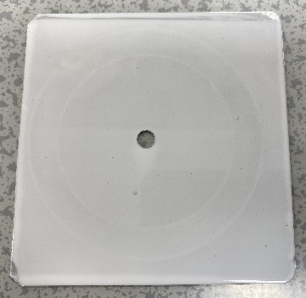
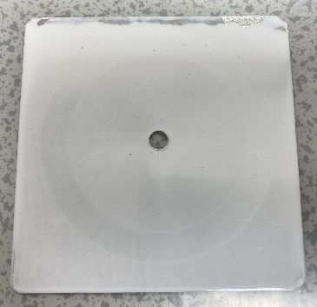
Taber Abrasion Resistance Test
Incozol LV Standard- after Taber Abrasion
Incozol-341 LV- after Taber Abrasion
Below 1% loss is considered to have very high abrasion resistance
Abrasion Resistance (CS-17) (mg/1000 cycles: BS EN ISO7784-2
Enhanced ability to withstand wear and friction using Incozol-341 LV making it suitable for demanding applications

Slide 27
scratch resistance
Improved scratch resistance for both steel and aluminum substrates
 | Steel |  |  |  |  |  | Aluminium
Pass/Fail | 2K PU Heavy Duty White TC (Inc LV Std) |  |  | 2K PU Heavy Duty White TC (Incozol-341 LV) |  |  | 2K PU Heavy Duty White TC (Inc LV Std) | 2K PU Heavy Duty White TC (Incozol-341 LV)
 | Cleaned | Abraded | Not Abraded or Cleaned | Cleaned | Abraded | Not Abraded or Cleaned
Mark( g) | 100 | 100 | 100 | 100 | 100 | 100 | 100 | 100
Pass (g) | 2500 | 2400 | 2500 | 2100 | 2500 | 3000 | 1200 | 1400
Failed (g) | 2600 | 2500 | 2600 | 2200 | 2600 | 3100 | 1300 | 1500
Improves scratch resistance even on unprepared surfaces
Performs consistently across steel and aluminium
No compromise in performance with Incozol-341 LV

Slide 28
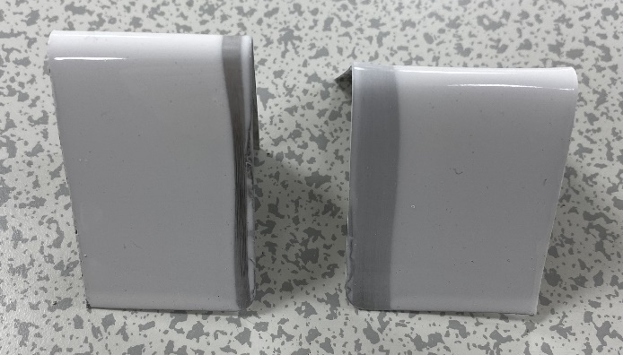
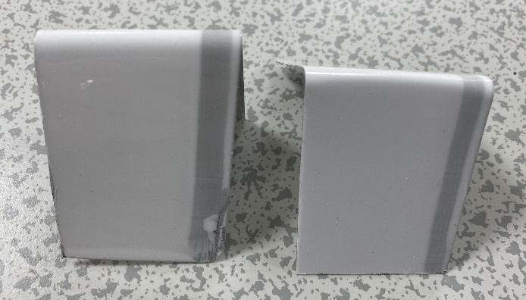
mandrel bend (flexibility) test
Excellent ability to withstand deformation without cracking and delaminating
Mandrel Bend Test- Incozol LV Standard (6 mm and 2 mm)
Mandrel Bend Test – Incozol-341 LV (6 mm and 2 mm)
Mandrel Bend (Flexibility) Test
Test | Method/Standard | Time Period /Conditions | Mandrel Size | 2K PU Heavy Duty White TC (Inc LV Std) | 2K PU Heavy Duty White TC (Incozol-341 LV)
Mandrel Bend Test (Pass/Fail) | ASTM D 522 -A | 7 days @RT | 2 mm | Pass | Pass
 |  |  | 6 mm | Pass | Pass

Slide 29
adhesion test (cross hatch)
No loss in adhesion performance using Incozol-341 LV
Cross Hatch Adhesion Test (Steel)
Test | Method/Standard | Time Period | Condition | 2K PU Heavy Duty White TC (Inc LV Std) | 2K PU Heavy Duty White TC (Incozol-341 LV)
Cross Hatch Adhesion Test (Rank/ Percentage intact) | ASTM D 3359 | 7 days @RT | Cleaned | 4B- 97% | 5B- 100%
 |  |  | Abraded and Cleaned | 5B- 100% | 4B- 97%
 |  |  | Not Abraded or Cleaned | 2B- 15-35% Affected area | 5B- 100%
Scoring key
Rank | % Removed
5B | 0
4B | <5
3B | 5 to 15
2B | 15 to 35
1B | 35 to 65
0B | >65

Slide 30
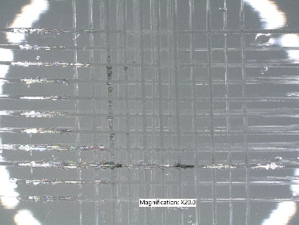
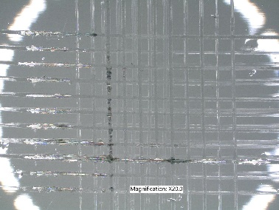
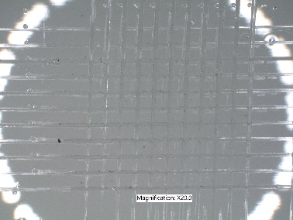
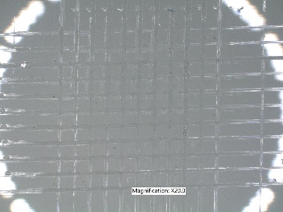
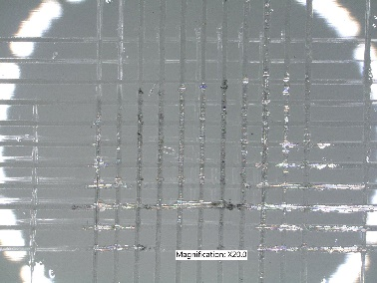
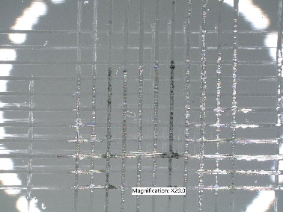
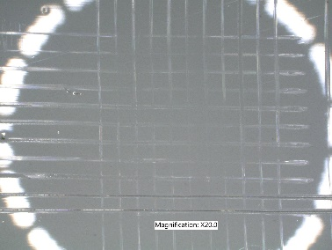
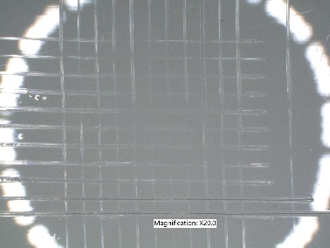
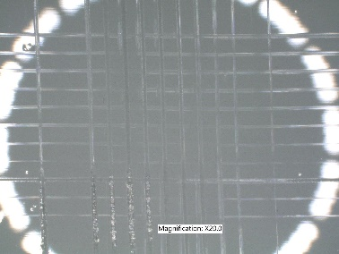
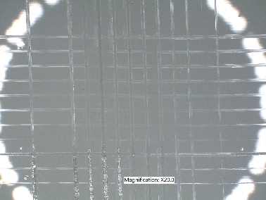
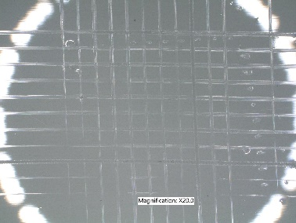
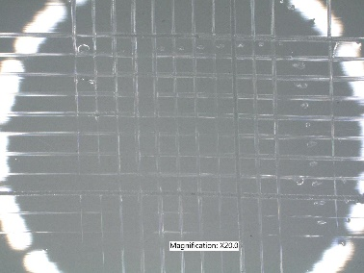
Incozol lv tests results
Adhesion Test (Cross Hatch)
Incozol LV Standard
Incozol-341 LV
Incozol LV Standard- Cleaned before tape
Incozol LV Standard- Cleaned before tape
Incozol LV Standard- Abraded before tape
Incozol LV Standard- Abraded after tape
Incozol LV Standard- Not Abraded or Cleaned before tape
Incozol LV Standard- Not Abraded or Cleaned before tape
Incozol-341 LV - Cleaned before tape
Incozol-341 LV - Cleaned after tape
Incozol-341 LV - Abraded before tape
Incozol-341 LV - Abraded after tape
Incozol-341 LV - Not Abraded or Cleaned before tape
Incozol-341 LV - Not Abraded or Cleaned after tape

Slide 31
Summary – 2k pu automotive refinish clearcoat
✓✓ = Good ✓✓✓ = Excellent
 | Incozol LV Standard | Incozol-341 LV
Appearance | ✓✓✓ | ✓✓✓
Potlife | 40 | 40
1 day hardness | ✓✓ | ✓✓✓
7 day hardness | ✓✓ | ✓✓✓
Drying time | ✓✓ | ✓✓✓
Chemical and Stain Resistance | ✓✓✓ | ✓✓✓
Abrasion Resistance | ✓✓ | ✓✓✓
Scratch resistance (abraded steel) | ✓✓✓ | ✓✓✓
Mandrel bend | ✓✓✓ | ✓✓✓
Adhesion | ✓✓ | ✓✓✓

Slide 32
Summary – 2K PU heavy duty white topcoat
✓✓ = Good ✓✓✓ = Excellent
 | Incozol LV Standard | Incozol-341 LV
Appearance | ✓✓✓ | ✓✓✓
Potlife | 45 | 40
1 day hardness | ✓✓ | ✓✓✓
7 day hardness | ✓✓✓ | ✓✓✓
Drying time | ✓✓✓ | ✓✓✓
Chemical and Stain Resistance | ✓✓✓ | ✓✓✓
Abrasion Resistance | ✓✓✓ | ✓✓✓
Scratch resistance (abraded steel) | ✓✓ | ✓✓✓
Mandrel bend | ✓✓✓ | ✓✓✓
Adhesion | ✓✓ | ✓✓✓

Slide 33
Incozol-341 LV
Clear Protective Topcoat
White Protective Topcoat
Better 1 day hardness
Better 1 day hardness
Better 7 day hardness
Drop in replacement
Better scratch resistance
Better scratch resistance
Same high performance as Incozol LV
Better adhesion
Better value
All other properties are the same for both formulas
Switch Effortlessly. Save Instantly.

Slide 34

Thank you for your attention

